Slide 1


Onsite Optimisation
A practical demonstration to ensure all web pages are fully optimised for the search engines whilst remaining informative, engaging and user-friendly.

Slide 2
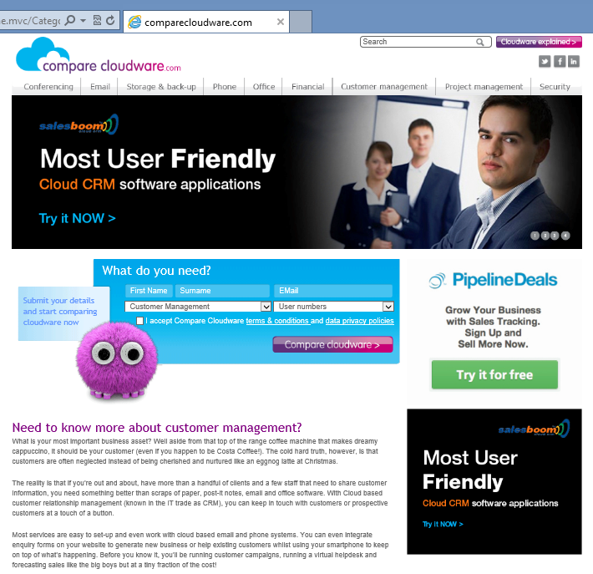
Overview
This document is designed to provide you with an overview of the main factors involved in onsite SEO.
Our intention is to provide you with the information you need to create engaging, user-friendly content that is fully optimised to encourage a stronger presence in the search engines.
Example Page: Customer Management
Current URL: http://www.comparecloudware.com/home.mvc/CategoryPage?categoryID=2&scripting=True

Slide 3

Meta Information
Meta data is crucial for establishing the theme of each page to the search engines. The meta data on each page needs to be unique for the best results.
This is how your meta data appears within your Google listing:
Your meta keywords are not displayed.
Meta Title
Meta Description

Slide 4
Meta Information
This is how your meta data appears within the page source code
(sample taken from www.freelanceseoessex.co.uk homepage):

Slide 5
Notes on Meta Data
Meta Title Tag:
The title tag should be no longer than 70 characters in length (including spaces)
Your main targeted keyword should be placed at the front of the title, followed by either a secondary keyword, a USP, or supporting information for that page. If the character limit allows, your brand name can also be added to the end of the title.
Meta Keywords Field:
The search engines largely ignore keywords placed within the meta, but for optimisation consistency, we recommend adding 3 – 10 targeted keywords
Each keyword must be separated by a comma and a space
Meta Description Field:
The meta description should be no longer than 160 characters in length (including spaces)
This field should accurately describe what the page is about using 1-2 of your targeted keywords. Where possible, the brand name should be incorporated into the field

Slide 6
Example Meta Data
Example Meta Title:
Compare Customer Management Software | CRM Reviews | Compare Cloudware
Example Meta Keywords:
compare CRM, compare CRM software, buy customer management software, compare customer management software, best customer management software, customer management reviews
Example Meta Description:
Compare customer management software and CRM systems from top brands with UK independent website Compare Cloudware. Compare features and costs and buy online.

Slide 7
Code
There are a number of coding elements that need to be implemented to ensure the site is well optimised.
HTML Sitemap
Compare Cloudware already contains an HTML sitemap, available here:
http://www.comparecloudware.com/Home.mvc/SitemapPage?scripting=True
XML Sitemap
While an HTML sitemap is designed to be navigated by humans, an XML sitemap contains more in-depth information about page structure and is designed to be read by the search engines. It can be used to instruct the search engine bots as to which pages need to be crawled and indexed as a priority, and which pages need to be visited less frequently.
Please see the next slide for an example of an XML sitemap file.

Slide 8
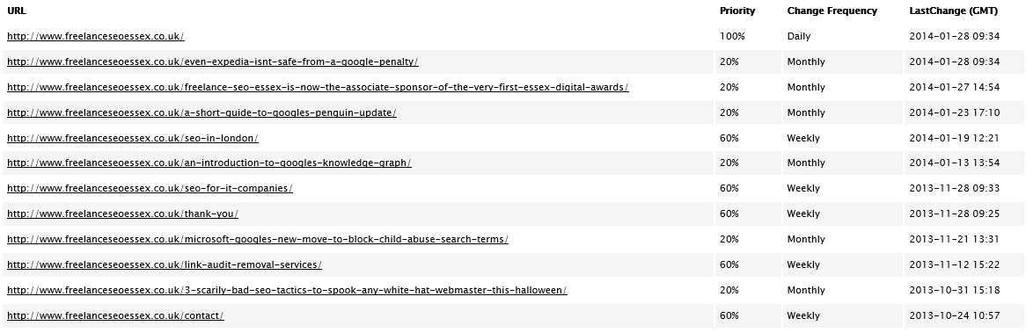
Example XML Sitemap
(sample taken from www.freelanceseoessex.co.uk/sitemap.xml):

Slide 9
Code
Robots.txt
The robots exclusion protocol (REP), or robots.txt is a text file webmasters create to instruct search engine robots how to crawl and index pages on their website.
The robots.txt is usually placed in the root folder of your web site, so its URL would resemble the following in the web browser:
www.comparecoudware.com/robots.txt
Crucially, robots.txt can be used to tell the search engines not to index a specific set of pages, for example:
Login Pages
Dynamic Search Results Pages
Blog Categories (where two different URLs could potentially be pointing to the same page of content)
If your developer wishes to use the robots.txt meta tag at page level instead of adding a file to the root folder, the following code will need to be added to the head section of each HTML page to ensure it is crawl-able:
<META NAME="ROBOTS" CONTENT="NOINDEX, FOLLOW">
More information on the correct use of robots.txt in SEO can be found here.

Slide 10
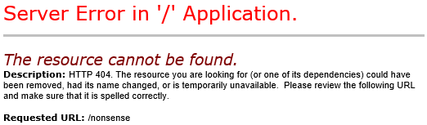
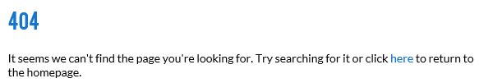
404 Error Page
Currently, when a user types in an incorrect URL extension for your domain comparecloudware.com, the error page looks like this.
To reduce your bounce rate and improve the user experience, this page should be customised using your branded template. It should also ideally point visitors in the direction of a Help page, FAQs page or alternatively back to your homepage to encourage them to stay on the site.

Slide 11
Structure & Headers
Clean URLs
Currently, the URLs on the site contain a lot of unnecessary code. These need to be streamlined to make them easier for the search engines to read.
Example:
http://www.comparecloudware.com/Home.mvc/CategoryPage?categoryID=2&scripting=True
Recommendation:
http://www.comparecloudware.com/customer-management

Slide 12
HTML Header Tags
The content on each page needs to be broken into sections using HTML header tags, which are numbered from 1-6 depending on importance (H1, H2, H3 etc). The search engines use HTML header tags to help determine the page’s relevancy for your targeted keywords.
Each page must only contain one H1. As an example, the following title on your Customer Management page meets the criteria for an H1:
Within the source code, the header tag would look like this:
<h1>Need to know more about customer management?</h1>
Further headers can then be incorporated into the text as they need to be. Generally, you should not need to use more than 3x H2s and perhaps a handful of H3s in your menu headings.
We recommend writing headers with your keywords in mind but not to the point of over-optimisation.

Slide 13
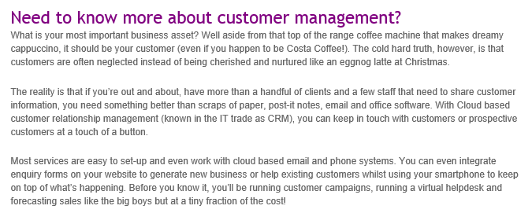
Page Content
Keyword Placement
Keyword placement is still a vital part of SEO, but the trick is to keep your content looking natural.
As a general rule, one of your targeted keywords (or a long-tail variation) needs to be mentioned in every 50 words of text. However, remember that keywords can also be incorporated into headers, titles and the alt tags behind your images.

Slide 14

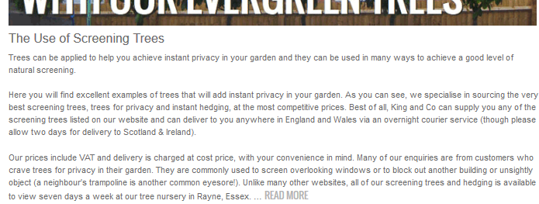
Adding Content
We recommend adding around 600 words of unique content to each page for optimum results. To ensure this much content does not interfere with the page design, you could contain the text in either a scroll box, a ‘read more’ button, or a tab framework.
Example Scroll Box: from freelanceseoessex.co.uk
Example ‘Read More’ Button: from kingco.co.uk

Slide 15

Adding Content
Example Tab System: from utilize.co.uk

Slide 16
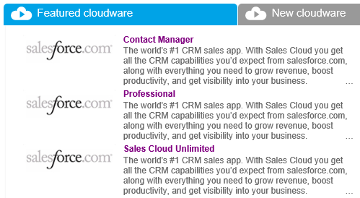
Duplicate Content
It’s important to ensure that all page content is unique. If you have copied and pasted text from an external site or elsewhere on your own site, Google will recognise this and may not index your page if it deems it to be repeating information that is held elsewhere.
This extends to provider and product pages, as seen on the right here.
Click here for more information on the implications of duplicate content in SEO.

Slide 17

Summary
Well-optimised meta data
HTML and XML sitemaps installed
Robots.txt implemented correctly
Customised 404 error page
Clean, SEO-friendly URLs
Adequate header tags
Natural keyword placement
Ways to manage content within the page design
Avoid duplicate content
www.freelanceseoessex.co.uk
Email: info@freelanceseoessex.co.uk
Telephone: 01245 477449 | 07840 155935

